Slide 1

Analysis of Factors Affecting Cardiovascular disease
Gems, Garry, Keegan, Young Gun

Slide 2
Table of contents
Data extraction and cleaning
01
04
02
Exploratory analysis
05
03
Decision tree
03
Random forest & KNN
outcome
conclusion

Slide 3
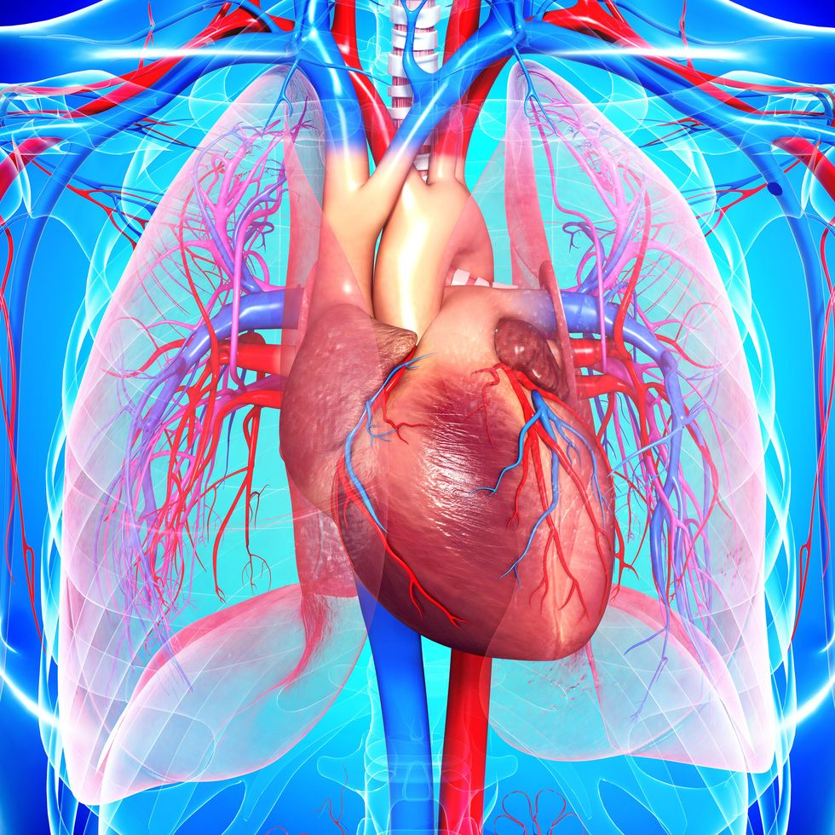
Data Set Used: Cardiovascular Disease Prediction

Slide 4
Cardiovascular disease (CVD) is the number one cause of death globally.
The number of deaths from CVD increased by 42.4% from 1990 to 2015. On the other hand, CVD led to over 17 million deaths, 330 million years of life lost and 35.6 million years lived with disability in 2017 worldwide. Meanwhile, it was projected that CVD would be the cause of more than 23 million deaths in 2030 around the world

Slide 5
Qn: Can we predict whether someone has cardiovascular disease

Slide 6

Data cleaning
# dropping id
df = df.drop(['id'], axis = 'columns')
# changing the year column into age
df['age'] = df['age'].map(lambda x: round(x/365))
# remove weight outliers using extreme ends of quantile
# remove height outliers using extreme ends of quantile
#removing datapoints where systolic blood pressure < diatolic blood pressure
Notes:
Height and weight in isolation are not very useful factors, so combining them into BMI would be more useful
Systolic and diatolic blood pressure are indicators of blood pressure, which can be separated into normal, higher than normal, Stage 1 Hypertension and Stage 2 Hypertension

Slide 7
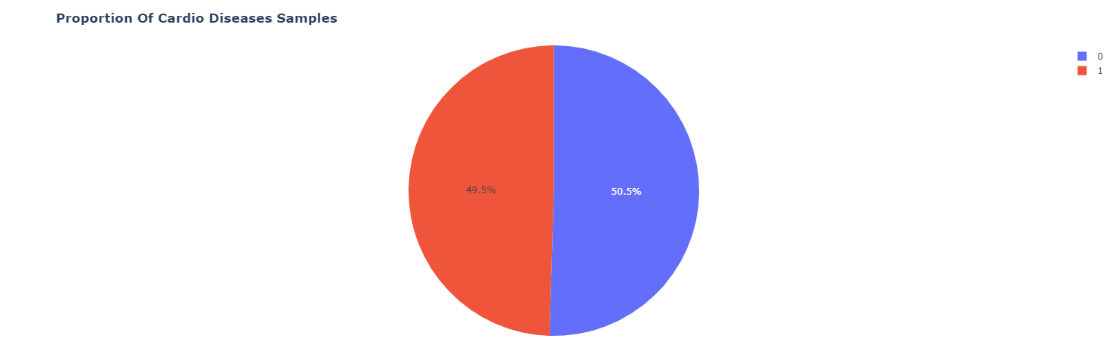
Cardiovascular Diseases
Notes:
Looking at whether classes are imbalanced, most important thing to start with is the original value we want to predict, cardio diseases

Slide 8
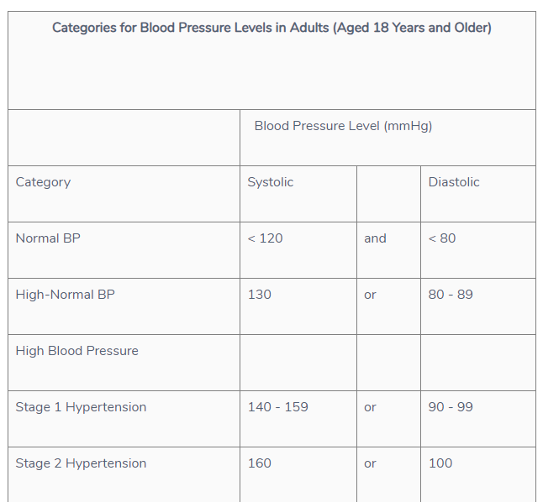
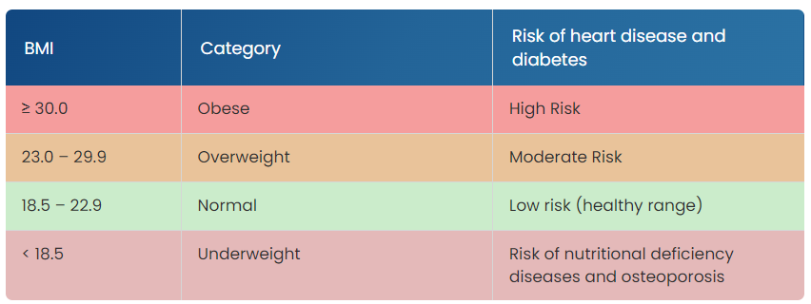
Guidelines for Singapore
https://www.myheart.org.sg/tools-resources/bmi-calculator/
Singapore Heart Foundation
HealthHub
Notes:
#defining bmi
#adding bmi into dataframe
Gender should be a category, with 1 = women, 2 = men
Cholesterol should be a category, with 1: normal, 2: above normal, 3: well above normal
Glucose should be a category, with 1: normal, 2: above normal, 3: well above normal
Smoking, alcohol use, active lifestyle and presence of cardiovascular disease should all be categories

Slide 9
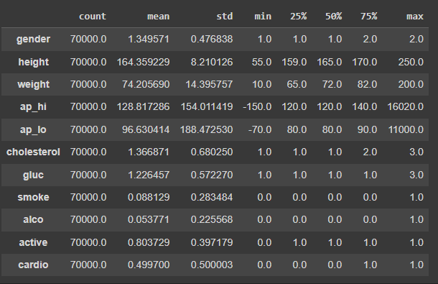
Data Shape

Slide 10

Data Shape

Slide 11
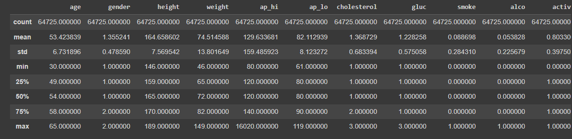
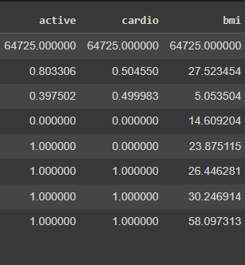
NEW data shape

Slide 12

Exploratory data analysis
Uni-Variate Exploration
Correlation
Notes:
Looking at individual variables,
Dataset is balanced, since presence of cardiovascular disease is roughly equal
For certain variables, such as presence of smoking, presence of alcohol consumption, the datasets are disproportionate and might not be sufficient to withold bias. Data also not necessarily precise, with just presence of smoking vs presence of alcohol consumption, and not frequency of smoking and frequency of alcohol consumption, but data is already disproportionate for these factors so frequency
Categorical variables naturally have dissonance between values because they are interpreted as integers
Effect of Age on Presence of Cardiovascular disease
What is the correlation between variables?
As observed from the correlation matrix, the factors with the highest correlation with presence of cardiovascular disease are (ranked)
Diatolic blood pressure (ap_lo) : 0.33
Age : 0.24
Cholesterol : 0.22
BMI: 0.19
Weight: 0.18
Predicting if a person has cardiovascular disease
Maybe try Random Forest and Naïve Bayesian models, checking later
Afterthought: Note that for diseases, it is ideal to minimize false negatives and error in predictions. Checking that data is balanced, we can use f1 score, but to minimize false negatives, looking at recall is better

Slide 13
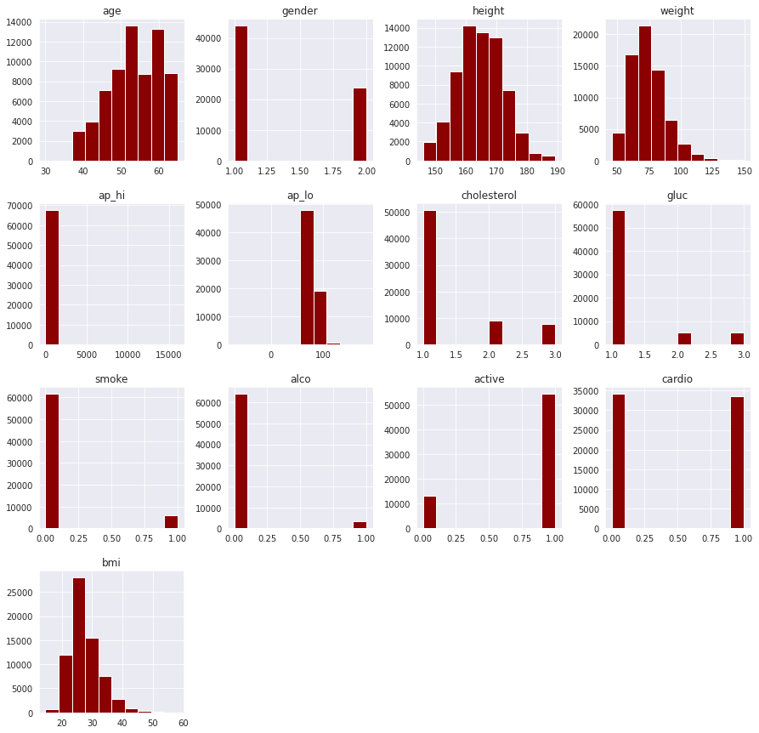
Histogram plots 2

Slide 14
Histogram plots

Slide 15
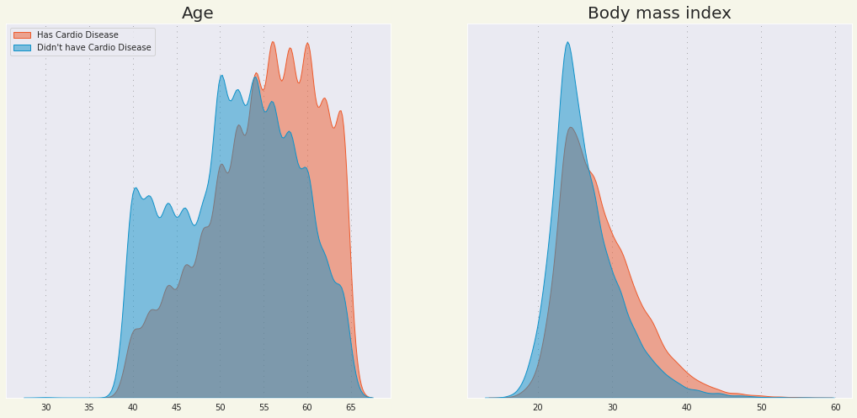
KDE plots
Notes:
KDE plots are more distinguishable the more the different plots differ from each other, overlap means no observable correlation

Slide 16
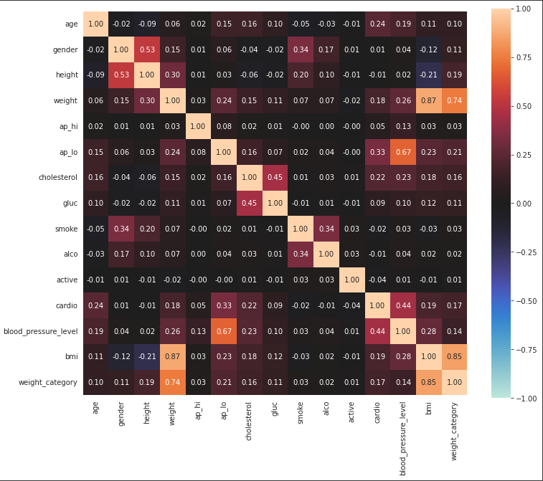
Correlation matrix

Slide 17
observations
Blood pressure level : 0.44
Diatolic blood pressure (ap_lo) : 0.33
Age : 0.24
Cholesterol : 0.22
BMI: 0.19
Weight: 0.18
Weight Category: 0.17

Slide 18
Conclusions
Certain classes of data are imbalanced/imprecise, and display low correlations with presence of cardiovascular disease (smoking, alcohol)
Data is generally leaning towards high aged, high BMI patients.

Slide 19
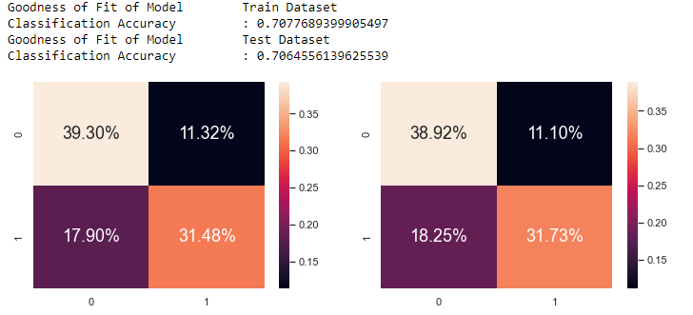
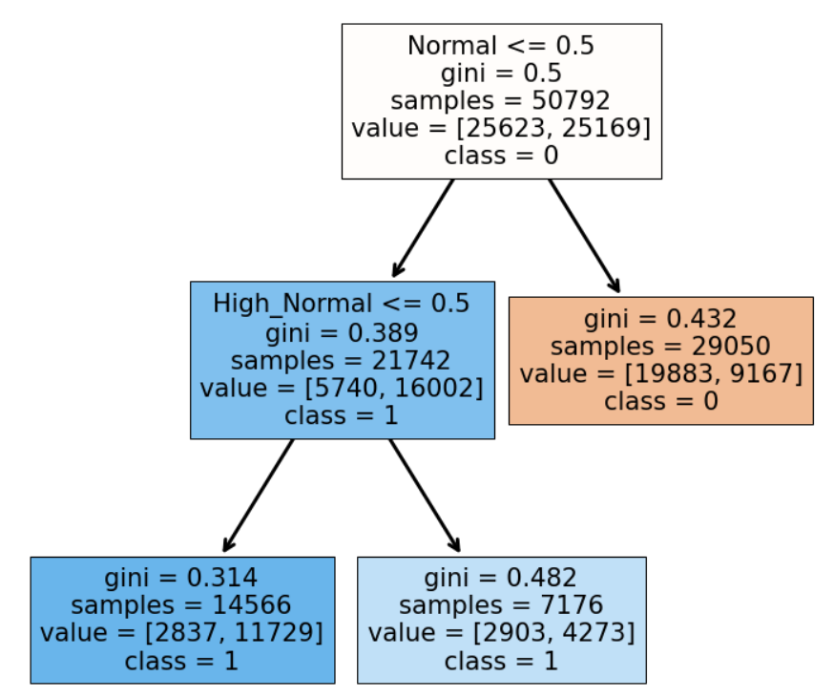
Decision tree (blood pressure level)
Notes:
We would now look to predict whether someone has cardiovascular disease through classification tree AI model.
First, we would use classification tree on the analysed top predictor.
Top Predictor (Blood pressure level)
Using blood pressure level we modeled a uni-variate tree model with a classification accuracy of 0.7102
2nd Predictor (Diatolic blood pressure ap_lo)
Uni-variate tree model has a classification accuracy of 0.6478
The best uni-variate model would be using the variable that has the highest correlation matrix to the cardio variable.
However, we can still make the tree classification AI model more accurate by using muti-variable
Multi-Variate Classification Tree (Variables larger than 0.05 correlation)
Age, Ap-hi, Ap-lo, cholesterol, glucose, bmi, blood pressure
The multi-variate model has a classification accuracy of 0.7277
Multi-Variate Classification Tree (All variables)
Classification accuracy of 0.7228

Slide 20
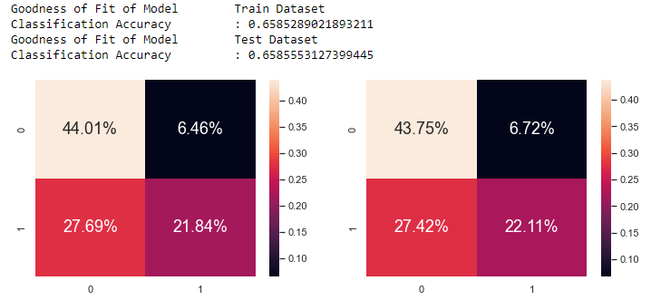
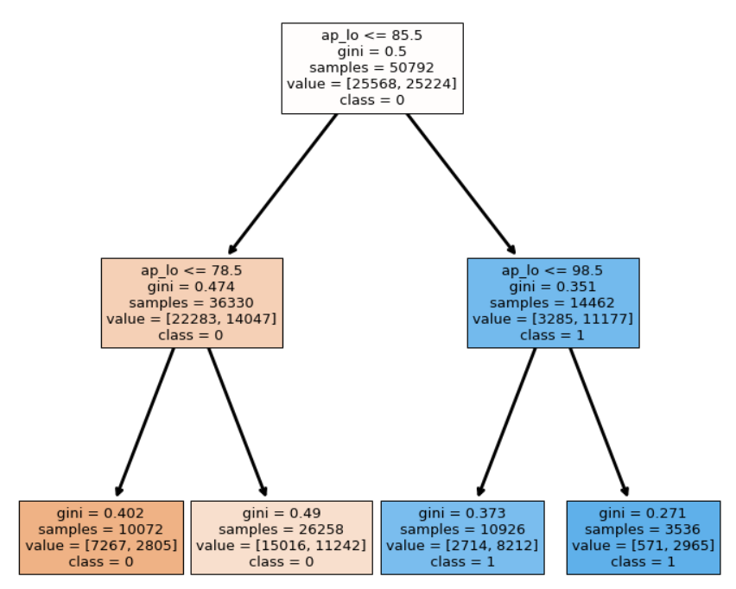
Diastolic blood pressure ap_lo

Slide 21
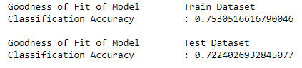
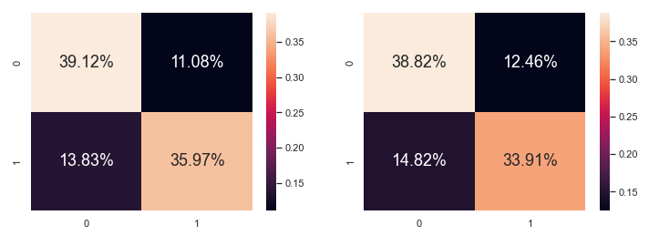
All Variables

Slide 22
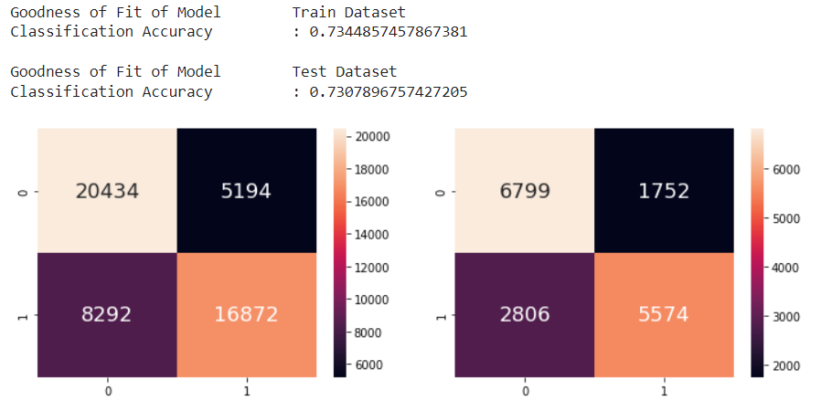
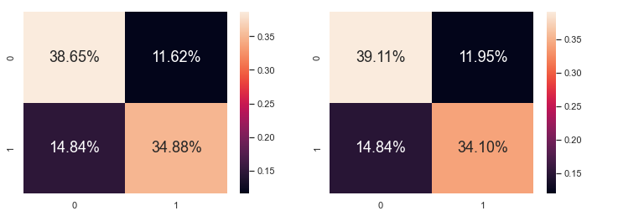
Feature Selection
(Top 7 Variables)

Slide 23
Other Machine Learning Models used

Slide 24
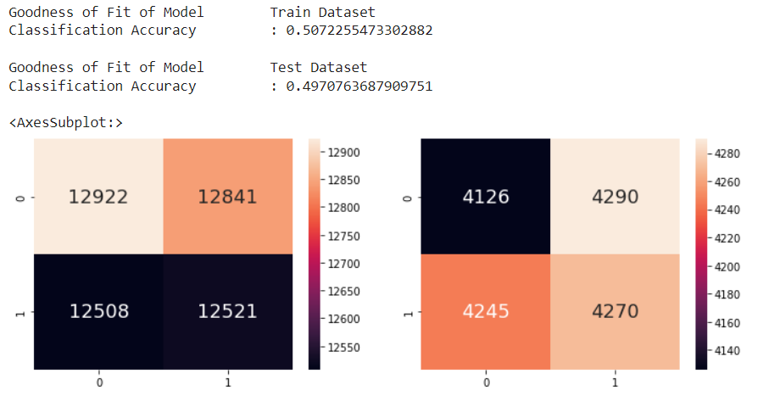
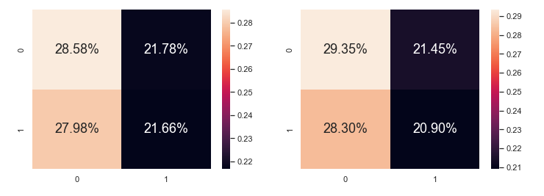
Dummy classifier
Notes:
The Dummy classifier model makes predictions without trying to find patterns in the data.
This model will be used as a baseline model that we can compare our other models (Decision Tree, Random Forest & K-Nearest Neighbours)

Slide 25
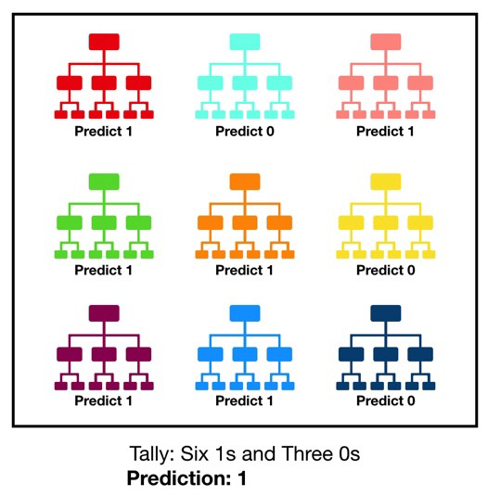
Random forest
Random forest utilizes TWO random processes, bootstrapping and random feature selection, hence it should be less sensitive to training data and reduce variance.
Notes:
ur group decided to use Random Forest and KNN algorithm to predict the presence of cardiovascular diseases, and evaluate which is the superior algorithm.
Base on the Correlation matrix generated in the Exploratory Analysis, our group have decided to drop id, gender, height, ap_hi, smoke, alco & active due to correlation with cardio < 0.05 in the Correlation matrix.
Our group also dropped weight & weight_category due to BMI (calculated from Height & Weight) having a higher correlation instead
Hence the factors taken into consideration: age, ap_lo, cholesterol,gluc, blood_pressure_level & bmi

Slide 26
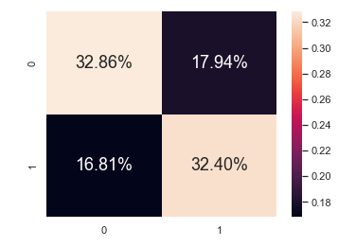
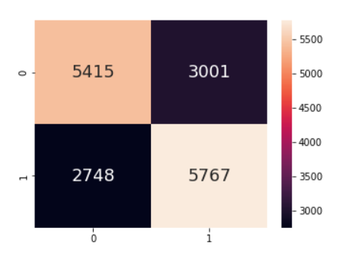

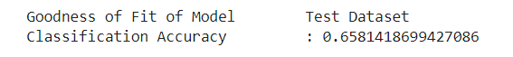
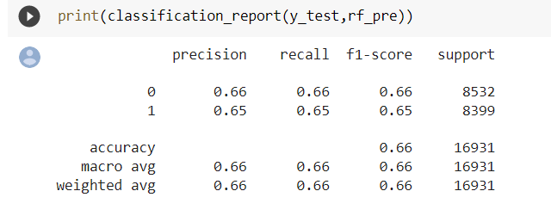
Classification report

Slide 27
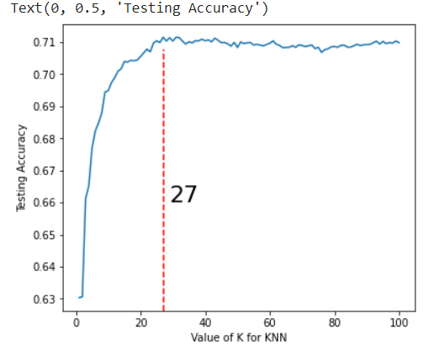
KNN K-Nearest Neighbours
The K-Nearest Neighbors algorithm is simple and accurate while being easy to implement.
Also, KNN only requires 2 hyper parameters in K value & distance metric.
Notes:
ur group decided to use Random Forest and KNN algorithm to predict the presence of cardiovascular diseases, and evaluate which is the superior algorithm.
Base on the Correlation matrix generated in the Exploratory Analysis, our group have decided to drop id, gender, height, ap_hi, smoke, alco & active due to correlation with cardio < 0.05 in the Correlation matrix.
Our group also dropped weight & weight_category due to BMI (calculated from Height & Weight) having a higher correlation instead
Hence the factors taken into consideration: age, ap_lo, cholesterol,gluc, blood_pressure_level & bmi

Slide 28
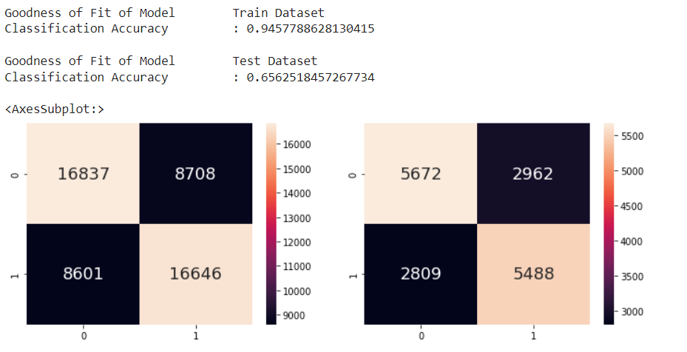
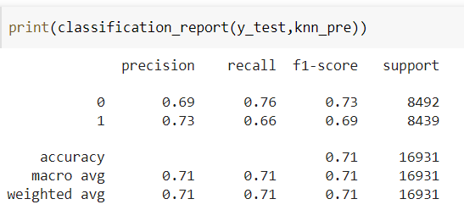
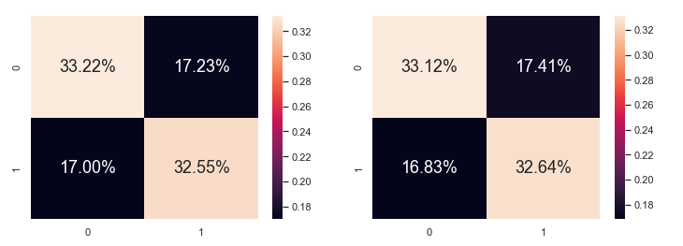
K-Nearest neighbour (knn)

Slide 29
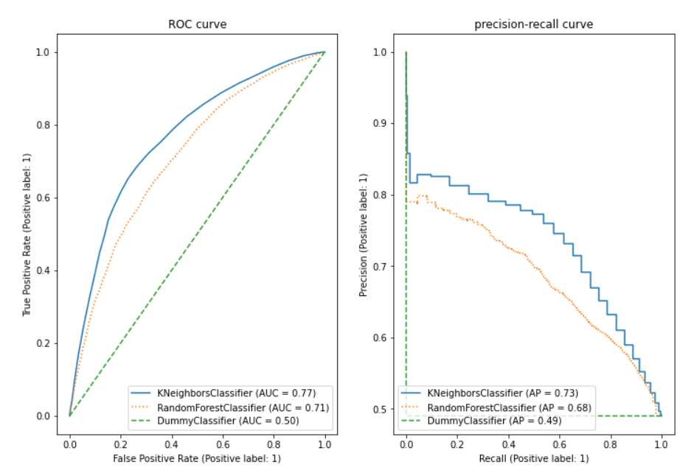
Roc & precision-recall curve

Slide 30
Evaluating in the real world context
More practical & valuable to prioritize reducing False negatives and increasing the True positive rate, in order to identify more potential patients correctly to seek treatment early and save more lives.
Notes:
It is perhaps more practical & valuable to prioritize reducing False negatives and increasing the True positive rate, in order to identify more potential patients correctly to seek treatment early and save more lives. Hence from this screenshot, the RF model is superior with a higher True positive rate of 0.65773 compared to KNN’s 0.65612

Slide 31
CONtributions
Gems
Data extraction & cleaning
Garry
Exploratory analysis, ML models & Gridsearch,
Compilation of report
Keegan
Classification tree
Young gun
Random forest and knn

Slide 32
Thank you

